Slide 1
COSC3000 Visualisation Project Presentation
Ryan White - s4499039
Semester 1, 2021

Slide 2
Earth Orbits of Note
(For this project)
LEO - Low Earth Orbit
GTO - Geostationary Transfer Orbit
GEO - Geostationary Orbit

Slide 3
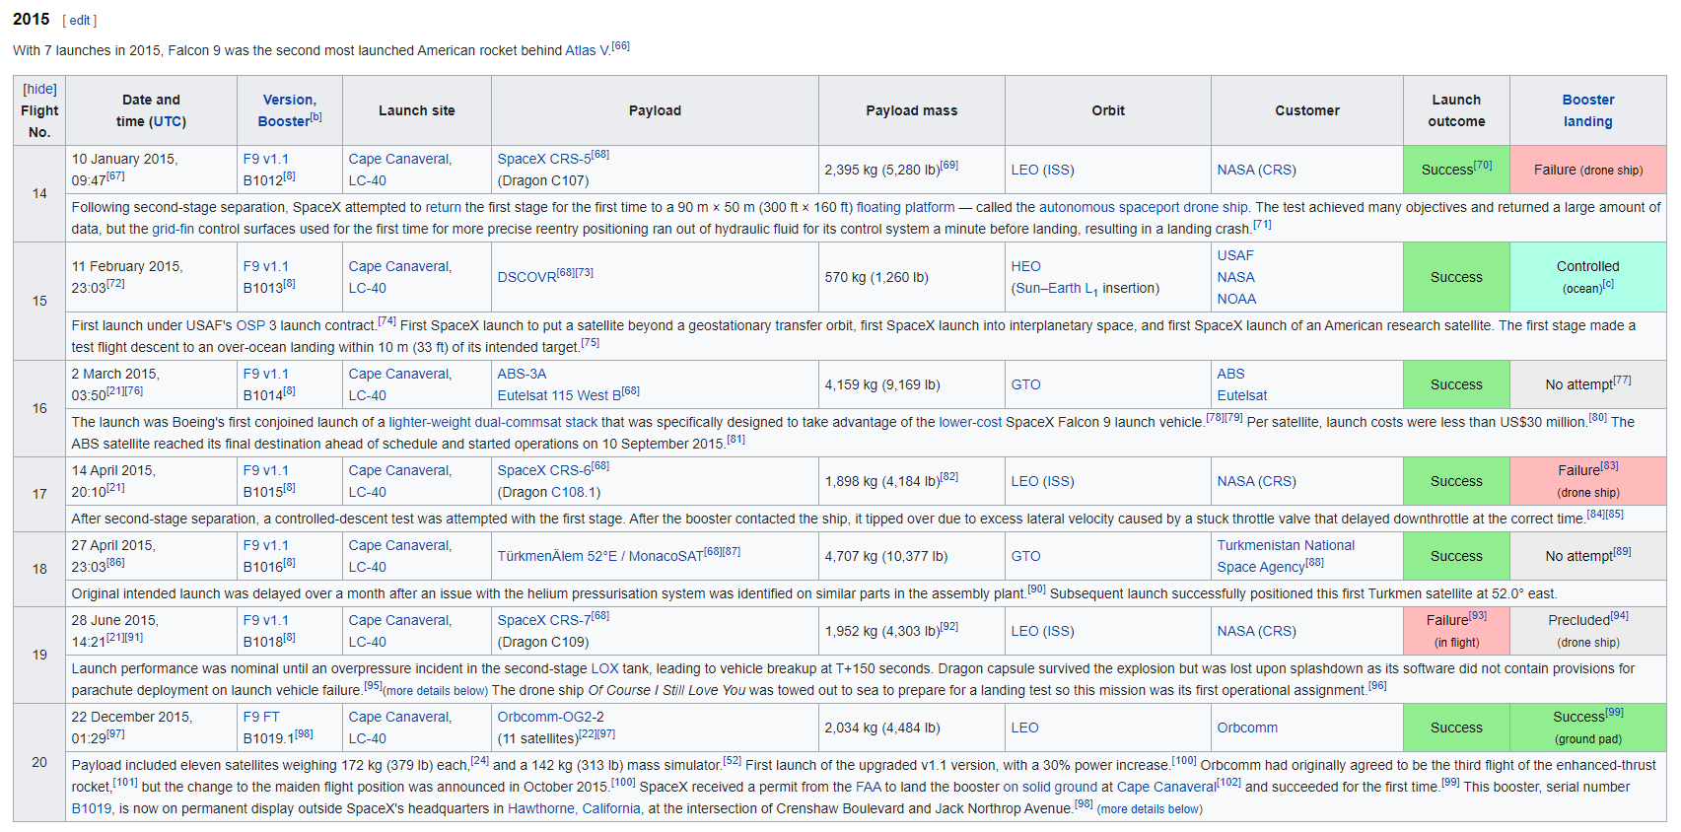
Example Wikipedia Data Table
Source: https://en.wikipedia.org/wiki/List of Falcon 9 and Falcon Heavy launches

Slide 4
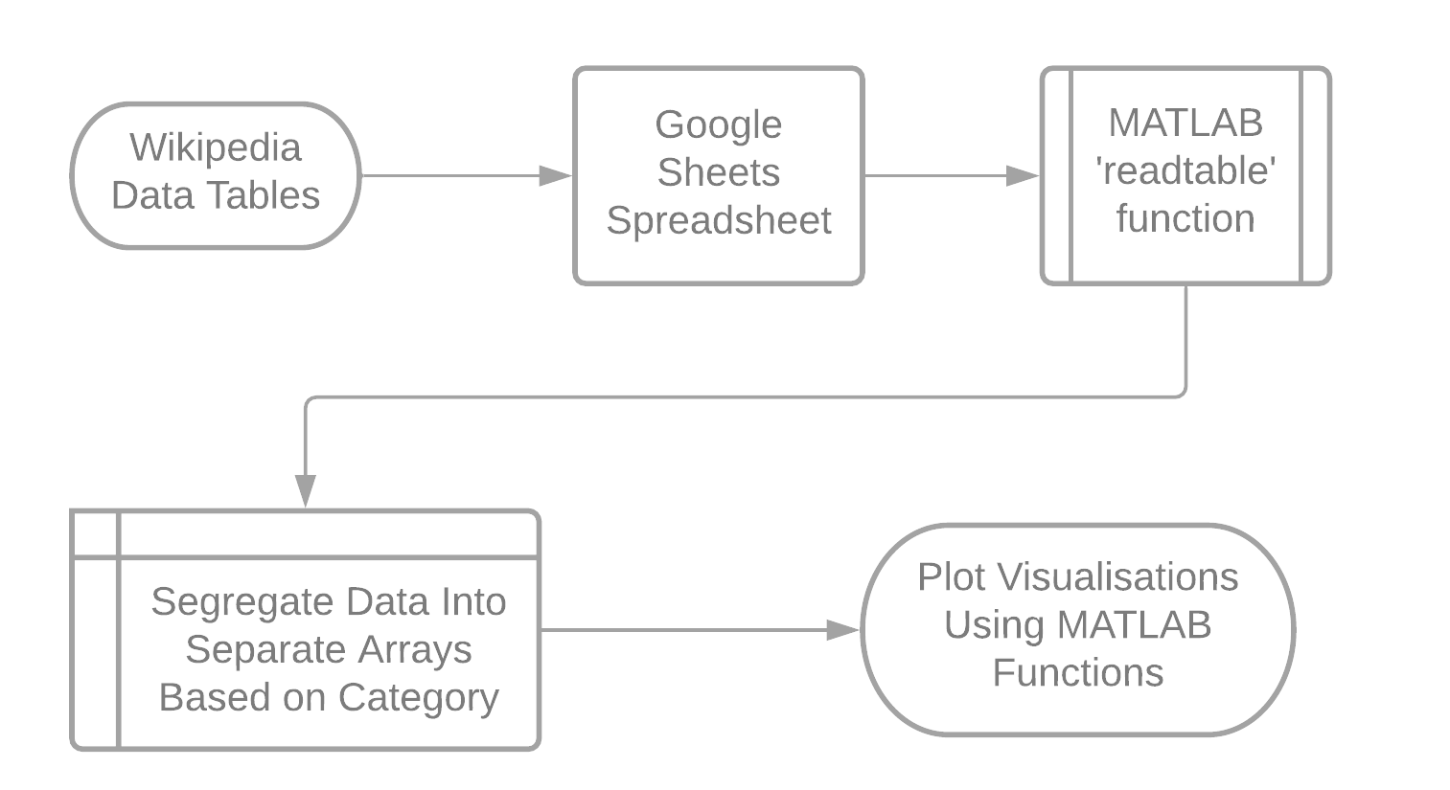
Data Collection and Methodology

Slide 5
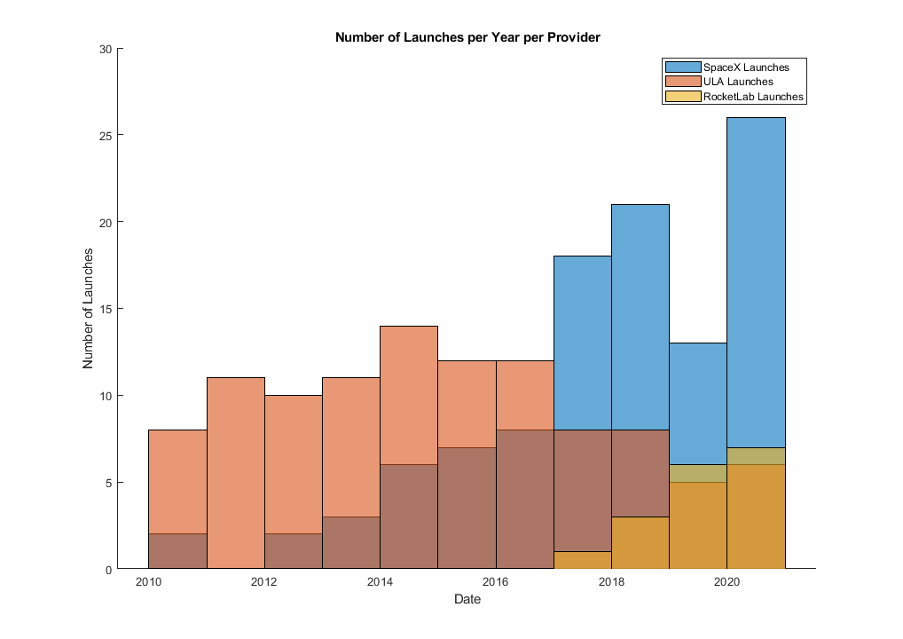
Figure 1: Number of Launches Per Year Per Provider
Uses the MATLAB histogram function, using the ‘Year’ binmethod to plot datetime formatted data.

Slide 6
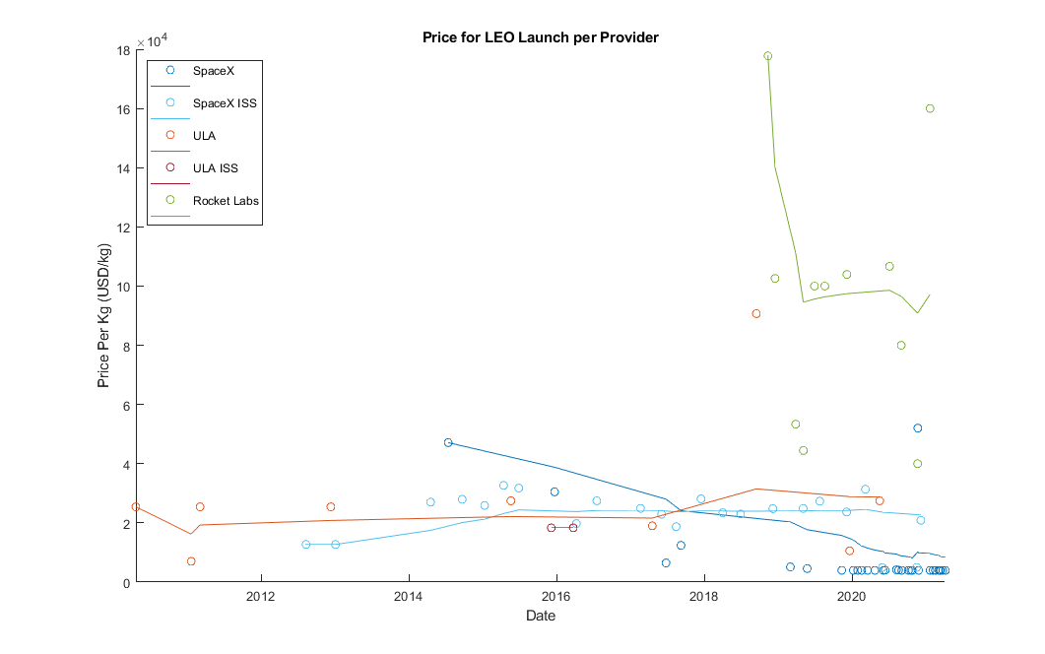
Figure 2: Price per Unit Mass to Low Earth Orbit by Provider

Slide 7
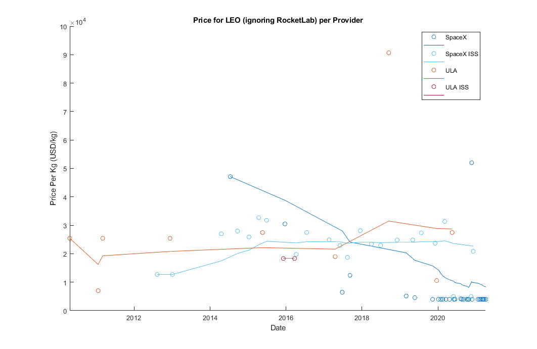
Figure 3: Price per Unit Mass to Low Earth Orbit by Provider (ignoring RocketLab)
Ignoring RocketLab, the competition between ULA and SpaceX is clearer.
Rolling Average lines plotted with MATLAB plot and movmean function, with individual data points for each launch plotted with the scatter function.

Slide 8
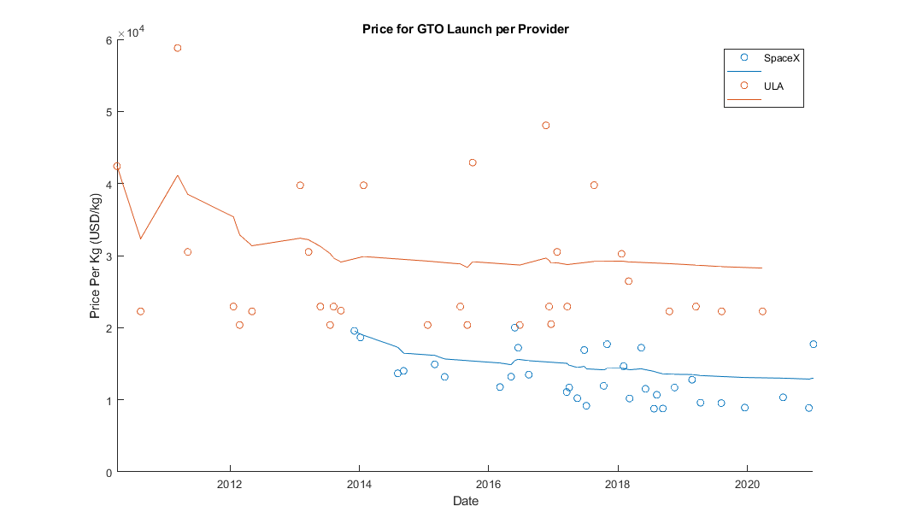
Figure 4: Price per Unit Mass to Geostationary Transfer Orbit by Provider
SpaceX consistently cheaper than ULA for every launch.
Greater density of SpaceX data points towards the end of the decade.

Slide 9
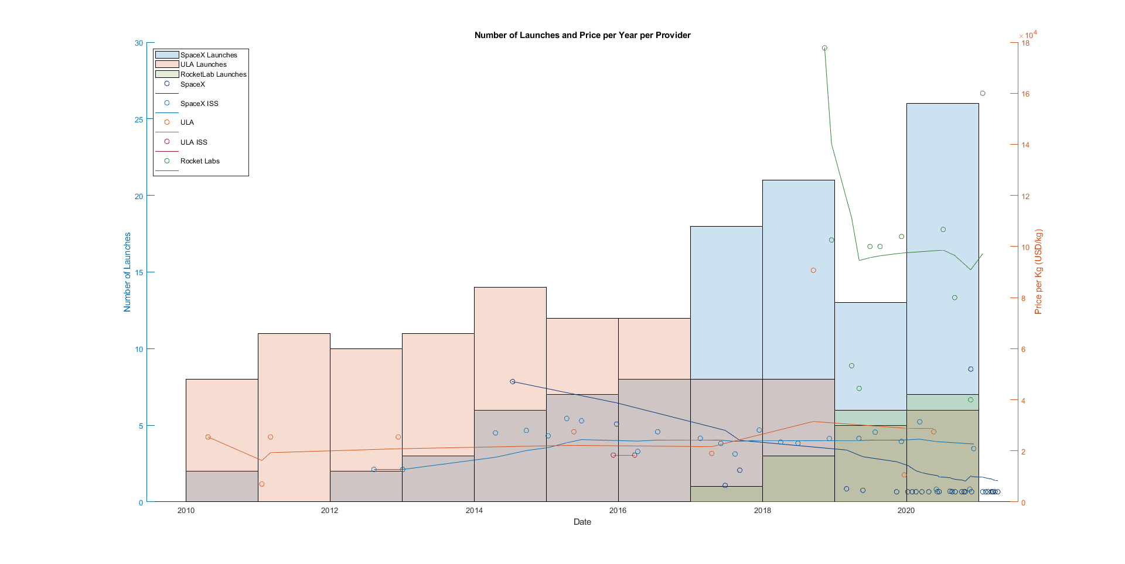
Figure 5: Relationship between LEO Price and Number of Launches
Convoluted, but succinctly shows relationship between cost and presence.
Combines Figures 1 and 2, with their y-axes on the left and right respectively.
2017 marked the turning point for dominant provider.

Slide 10
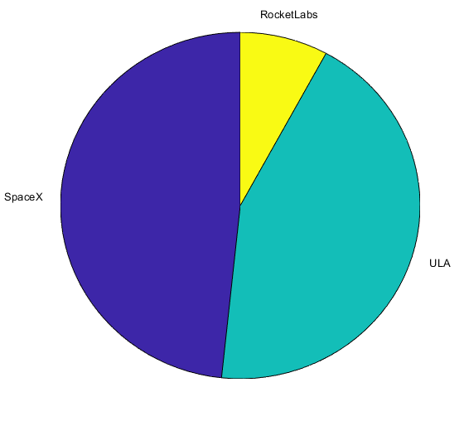
Figure 6: Launch Provider Proportion of Launches Between 2010-2020
Messy and ugly, MATLAB’s pie function made customisation difficult.
Shows a 1 dimensional proportion at the close of the decade.

Slide 11
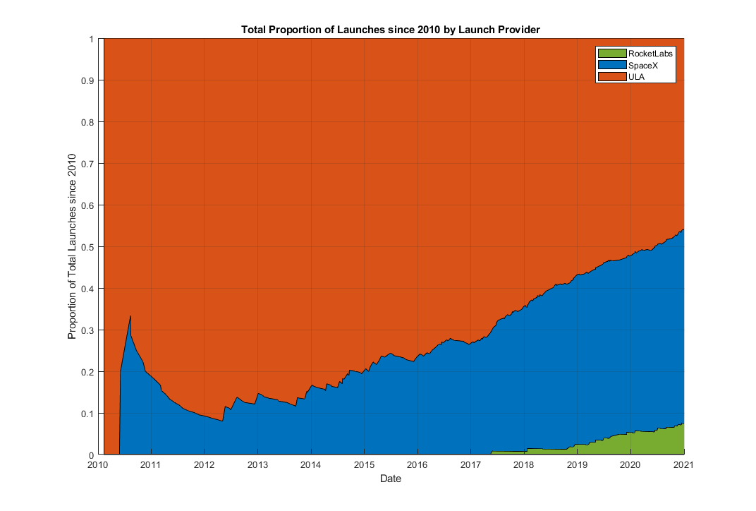
Figure 7: Total Proportion of Launches since 2010 by Launch Provider
Shows proportion between providers, with the added dimension of time.
Accurately shows cumulative proportion at any point in the decade.
By far the most difficult visualisation to create.

Slide 12
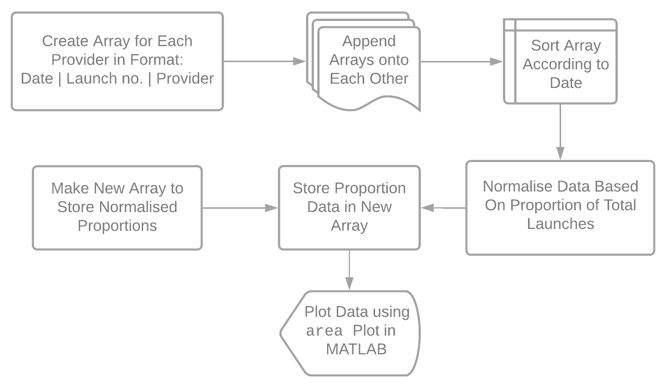
Programming Figure 7

Slide 13
In Conclusion...
Use of visualisations aided in identifying a relationship between key launch parameters
Even though some were convoluted, a relationship was found between launch price and number of launches per year
SpaceX ended the 2010-20 decade as the dominant launch provider, despite not having ever launched a Falcon 9 before 2010.
Further analysis in the 2020s would help solidify the inferred relationship between launch cost and market share, especially with SpaceX’s Starship, ULA’s Vulcan, and RocketLab’s Neutron rockets in development.

